Slide 1

Bus-Aware Multicore WCET Analysis through TDMA Offset Bounds
Timon Kelter, Heiko Falk, Peter Marwedel
TU Dortmund, Computer Science 12
Design Automation for Embedded Systems
Sudipta Chattopadhyay, Abhik Roychoudhury
National University of Singapore,
School of Computing

Slide 2
Outline
Introduction & Motivation
System Model
Analysis of TDMA Arbitration Delays
Results
Summary & Future Work

Slide 3
Worst-Case Execution Time (WCET) Analysis
Hard Real-Time Systems and Schedulability Analysis require safe WCET values → Static Analysis (Abstract Interpretation)
State-of-the-art: Industrial-strength Static Singlecore WCET Analysis
New scenario: Multicore Environments
Main problem: Shared resources (Arbitration) → New dependencies for timing analysis

Slide 4






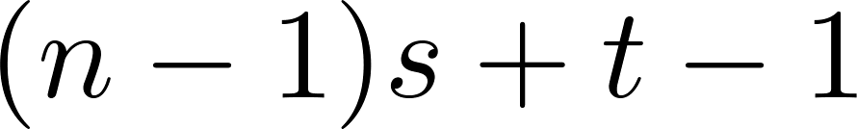
Predictability Properties of TDMA arbitration
Various standard arbitration alternatives exist
Here: TDMA / Time slicing scheduling → Favorable predictability properties
Central: All cores can be analyzed separately
Delay does only depend on the point in time of the access → Cyclicity: On the offset in the TDMA schedule
Trivial bound for delay:
Time
Core 1
Core 2
Core 3
Core 4
Time

Slide 5
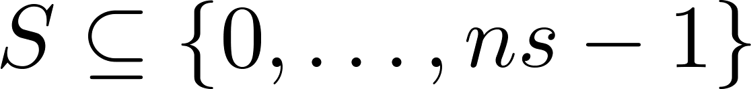
Predictability Properties of TDMA arbitration
Goal: Improve upon trivial delay bound
Idea: TDMA offset determines maximum access delay → For each access: Determine possible TDMA offsets
Time
Core 1
Core 2
Core 3
Core 4
Time
Access may be reached via different paths in CFG → Use sets of possible TDMA offsets
→ Offset overapproximation
ACC

Slide 6


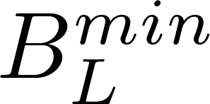
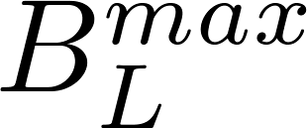

System Model
In-order SimpleScalar cores
Per Core:
Taskgraph
Fixed-priority, non-preemptive scheduling
Loop Bounds and for all loops
Data memory
Data memory
Data memory
…
Core
Core
…
Core
L1
I-Cache
L1
I-Cache
L1
I-Cache
Instruction
Memory
L2
I-Cache
Shared TDMA Bus:
TDMA slotsize
No split transactions
Notes:
Split transactions weglassen
Datenzugriffe direkt auf Bus legen, ohne Cache

Slide 7
WCET Analysis Framework
Per Core:
L1 Cache
Analysis
L1 Cache
Analysis
L1 Cache
Analysis
Determines, which instructions might access the bus
…
L2 Cache
Analysis
Determines possible interference in shared L2 cache
Pipeline
Analysis
Provide numerical parameters (instruction runtime)
WCET
Analysis
Bus access delay analysis & WCET computation
WCET
Analysis

Slide 8
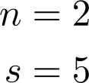
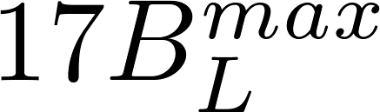
Global Convergence Approach
{0}
{0,3}
mark: add
mul
…
{0,3,6}
TDMA schedule
3
{3}
{3,6}
{3,6,9}
0
1
2
3
4
5
6
7
8
9
1
{3}
{3,6}
4
{3,6,9}
sll
{4}
Core 1
Core 2
{4,1}
{4,1}
2
{4}
{4,1}
…
{4,1}
{6}
{6,3}
{6,3}
1
{6}
{6,3}
4
{6,3}
sub
{1}
Data-flow analysis / Abstract interpretation
Computes offset sets before/after block
Fixpoint reached → Safe offset information
{1,4}
{1,4}
{1}
{1,4}
…
beq mark
{1,4}
2
{3}
{3,6}
{3,6}
Core 1
WCET
Notes:
Erklärung zum Fixpunkt (warum ist da der Fixpunkt)

Slide 9
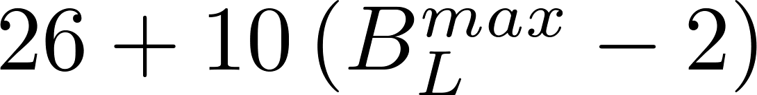
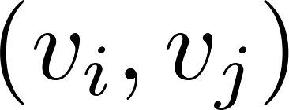

Graph-Tracking Approach
Problem: Global convergence cannot track cyclic offset progressions
Loop head in the example: 0, 3, 6, 6, 6, 6, … (cyclic at 6)
Idea: Capture this behavior with an offset graph
v⁺
10
13
13
v₀
v₁
v₂
v₃
v₄
v₅
v₆
v₇
v₈
v₉
v⁻
WCET
Edges represent single loop iterations, Weight: Iteration WCET for start offset

Slide 10
Graph-Tracking Approach
Build special flow problem in the offset graph → See paper for further details
The solution to this flow problem (ILP) yields:
Full loop WCET (including bus delays)
Resulting TDMA offsets after the loop execution
Handling of nested loops (similar: function calls)
Order of analysis: Innermost loops → Outmost loops
With results: Handle inner loops like single instructions
→ Structural reduction / folding

Slide 11
Test Setup
Prototype implemented in Chronos Framework
Includes:
Multi-level Cache Analysis
TMDA bus analysis
Missing features:
Pipeline Analysis
Testcases:
Mälardalen WCET benchmarks (MRTC suite)
PapaBench (multitask UAV control software)
Debie (multitask space-debris monitoring software)
Notes:
Pipeline-Analysis evtl nicht erwähnen

Slide 12
Test Setup
Xeon 2 GHz, 4GB main memory, Debian
ILP-Solver: CPLEX
Manual task mapping
Standard cache configuration
1KB L1 (direct mapped, block size 32 byte, 0 cycle access)
2KB L2 (4-way associative, block size 64 byte, 1 cycle access)
Main memory: 5 cycles access time
Debie cache configuration changes (1.6MByte Code)
2KB L1 (2-way associative)
8KB L2 (4-way associative)

Slide 13
Compared Approaches
Fully unroll all loops (known loopbound) ([6]) → Sequential code → Precise & Slow
Assume all loop iterations start at offset 0 ([8]) → Add penalty to compensate for possible underestimation → Less precise & Fast
Global Convergence Approach
Graph-Tracking Approach
Always use trivial bound

Slide 14
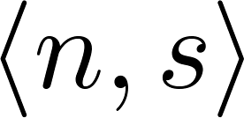
Experimental Results (Relative WCET)
→ Same precision as reference approach (+0,14%)
→ Works for all tested configurations

Slide 15
Experimental Results (Relative Runtime)
→ Way faster than reference approach (-79% to -99%)
Absolute Runtime:
~ 5h for Fully Unrolling for all experiments
Baseline:
Fully Unrolling ([6])

Slide 16
Summary & Future Work
TDMA offset analysis can provide useful static bounds for bus access times
Comparison against most precise known approach ([6]):
0,14% overestimation on average
13 times faster on average
Future work:
Extended prototype with pipeline analysis
Fine-tune graph-tracking analysis (clustering, expansion)
Heuristics to combine the advantages of the existing methods
Experiments with different architectures

Slide 17
Thank you for your attention!

Slide 18
Worst-Case Execution Times (WCET)
BCET_{est}
WCET_{est}
BCET
WCET
Runtime distribution
Possible execution times
Time
Estimated execution times (Overapproximation)
WCET in general not computable (Halting problem)
Upper timing bounds can be statically estimated ( WCET_{est})

Slide 19
Timing analysis of basic blocks
New block definition yields 2 cases
Block w/o bus access → Pipeline analysis will produce block WCET
Single-bus-access block → Compute offset sets before / after the block to bound delay
Data-flow analysis / Abstract interpretation
Computes offset sets before/after block
Fixpoint reached → Safe offset information
mark: add
mul
…
mark: add
mul
…
lw
…
sw
…
beq mark
lw
…
sw
…
beq mark

Slide 20
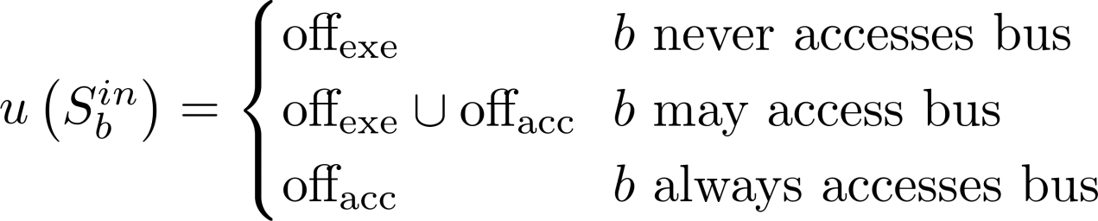
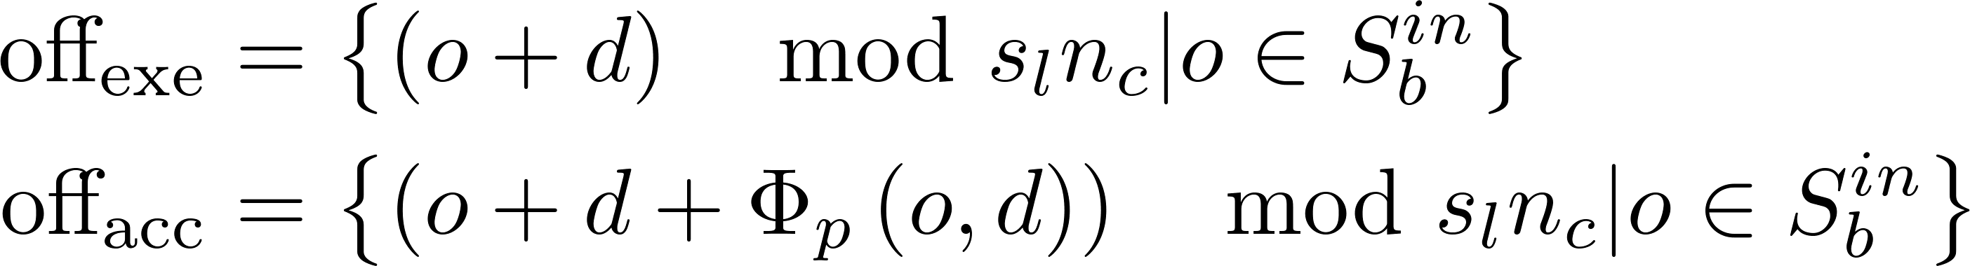
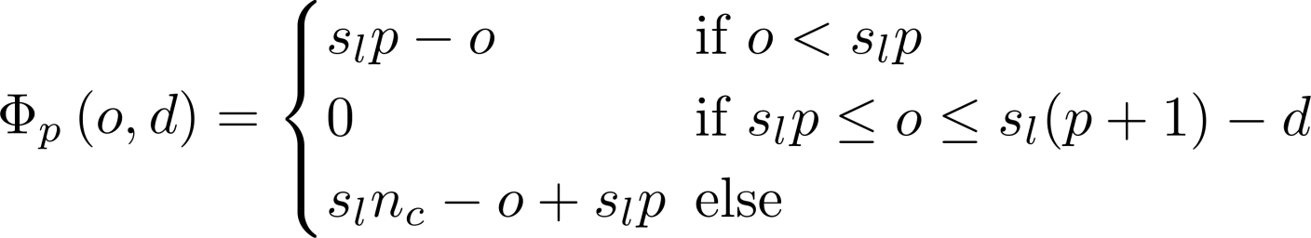
Abstract interpretation: Operators
Offset merge (at CFG joins)
Offset update (Abstract execution of basic block)
Core 1
Core 2
Core 3

Slide 21
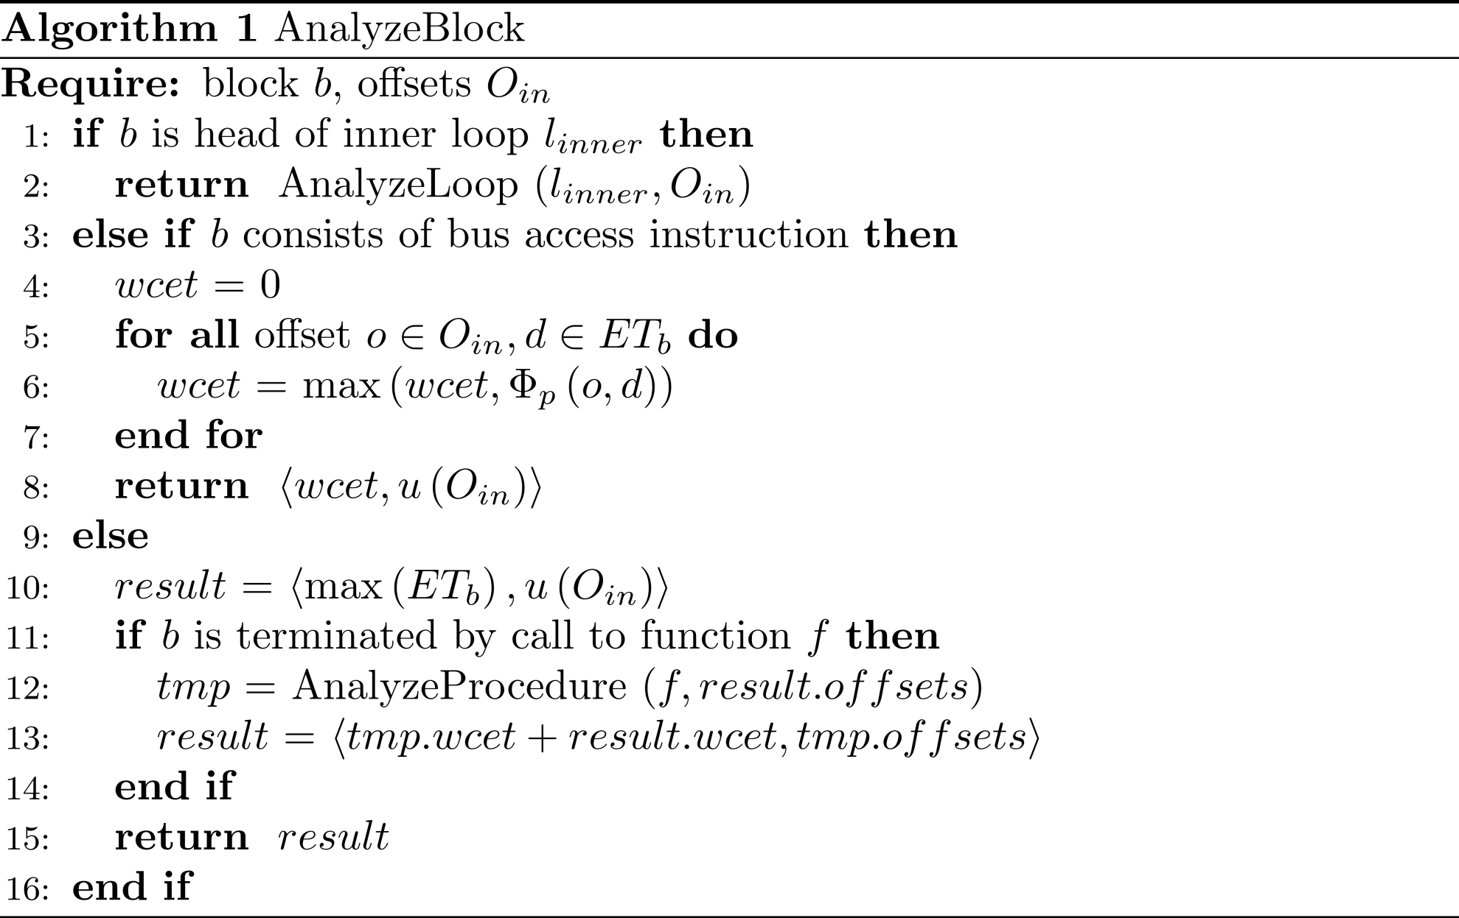
Algorithm: AnalyzeBlock

Slide 22
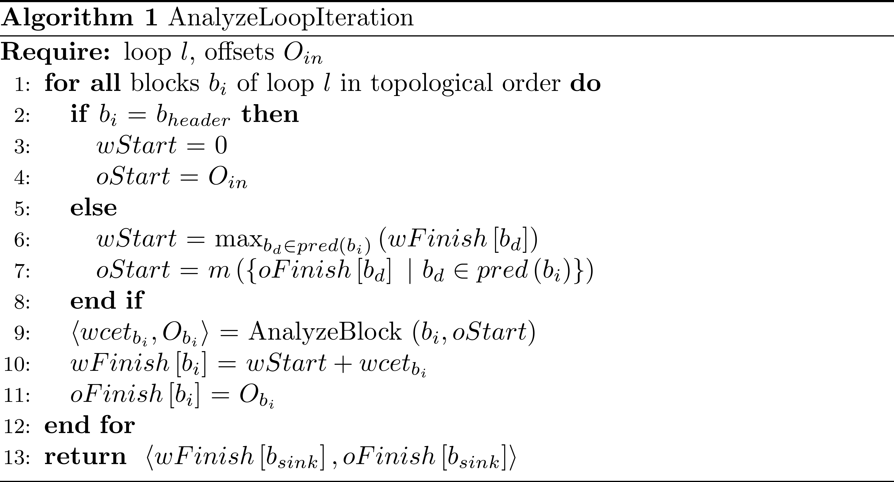
Algorithm: AnalyzeLoopIteration

Slide 23
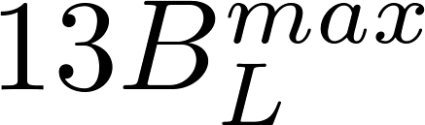
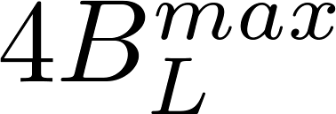

Global Convergence Approach
Base scenario: Single loop, no nesting, no function calls
For each BB in loop: Repeatedly compute resulting offsets for loop iterations, build overapproximation
Analysis
Iteration
Loop
WCET
{0}
{0,3}
mark: add
mul
…
{0,3,6}
Offsets (Red BB)
1
Core 1
Core 2
{3}
{3,6}
{3,6,9}
2
Core 1
Core 2
{3,6}
{3}
lw
{3,6,9}
…
3
Core 1
Core 2
…
Fixpoint → Stop
…
beq mark
Fixpoint valid for all loop iterations
WCET
{3,6}
{3,6}
{3}

Slide 24
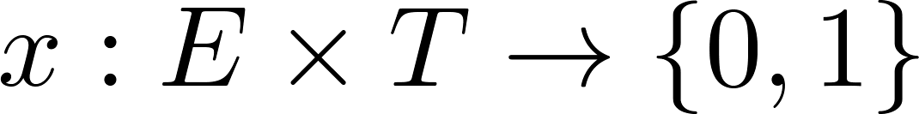

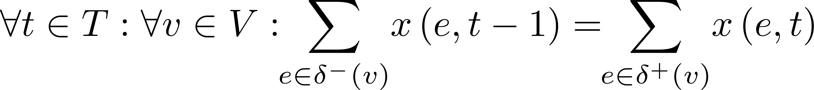
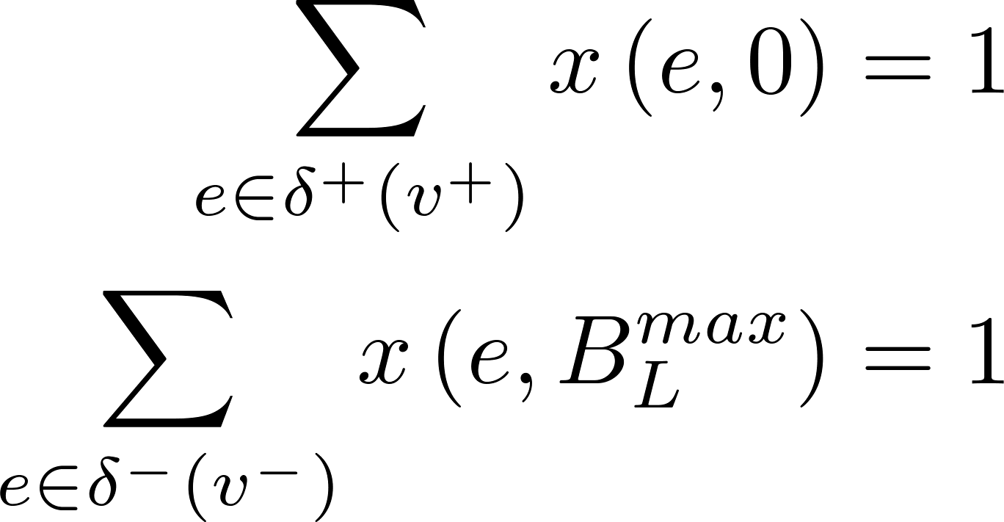
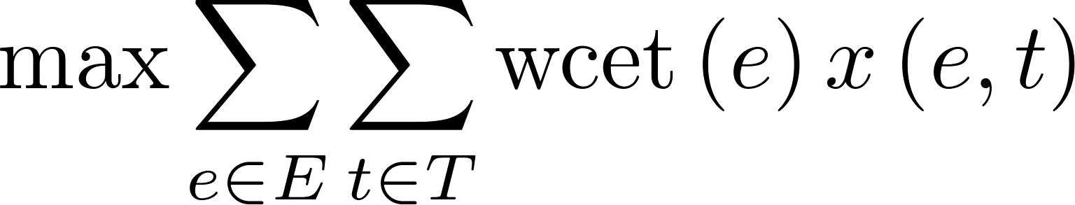
Graph-Tracking Approach
Compute dynamic flow through graph to determine loop WCET (flow unit simulates loop execution)
Flow function
Flow conservation
Start / End constraints
Objective function
Iteration t starts at offset i
and ends at offset j

Slide 25
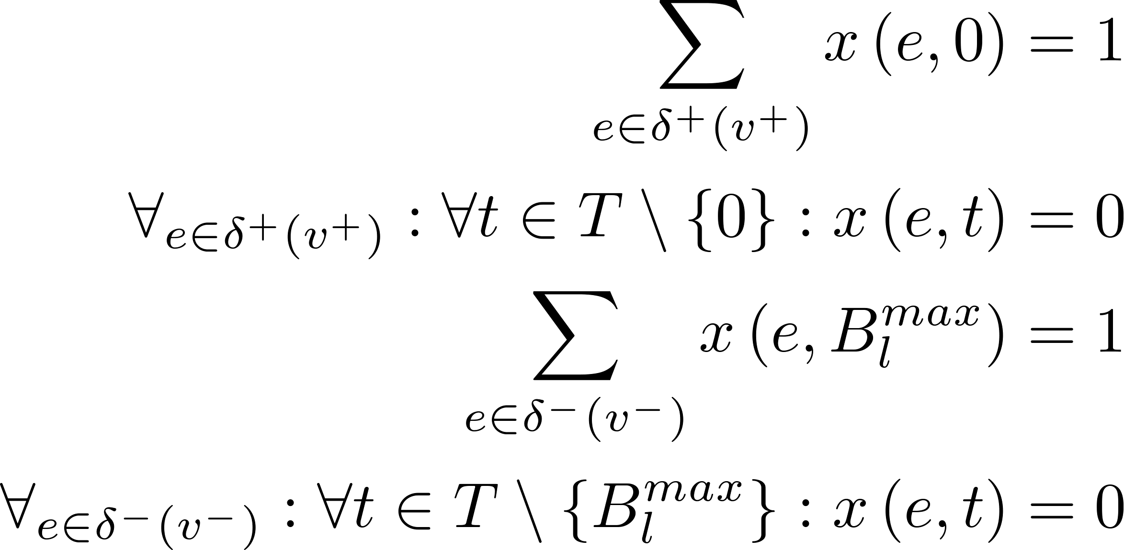
Graph-Tracking: WCET ILP
Variables:
Objective:
Subject to:

Slide 26
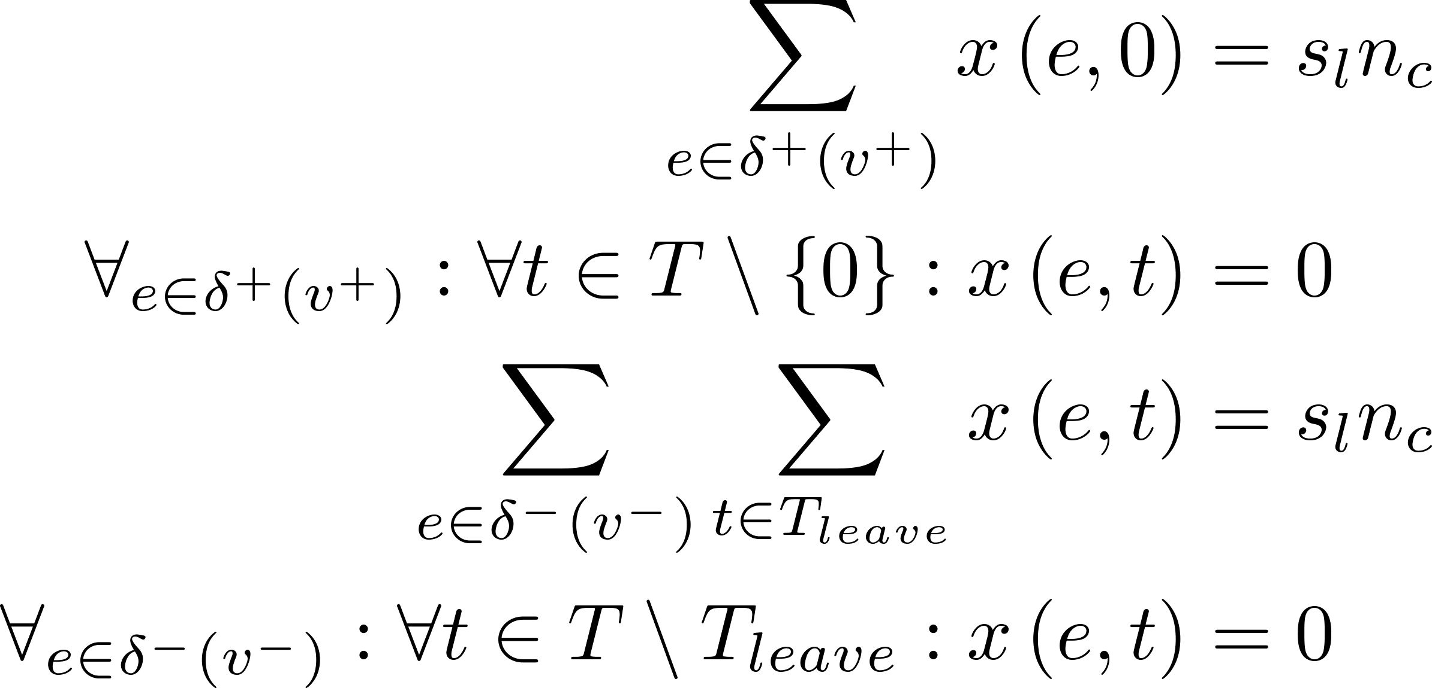
Graph-Tracking: Offset ILP
Variables:
Objective:
Subject to:

Slide 27
Extension for pipeline/branch pred. analysis
Global convergence: Build global overapproximation of hardware state
Graph-Tracking: Possible to build approximation per offset node for better precision

Slide 28
Discussion: Timing anomalies
The presented results were derived under the assumption of a timing-anomly-free system
Timing anomaly: Local worst-case behaviour does not lead to global worst-case behaviour → No pruning of search space
Pruning in case of offsets: Keep only a single worst-case offset when updating offset information (the offset which leads to maximum delay)

Slide 29
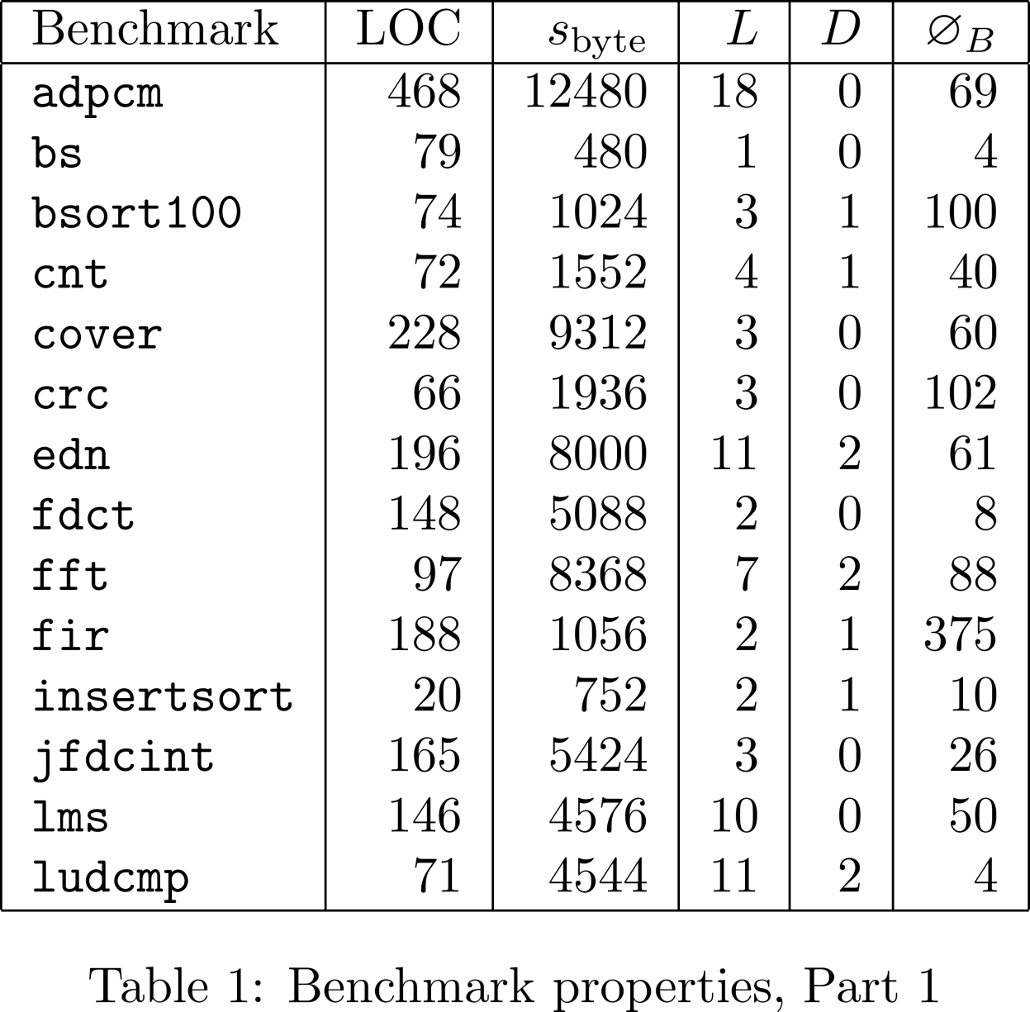
Benchmark Properties 1

Slide 30
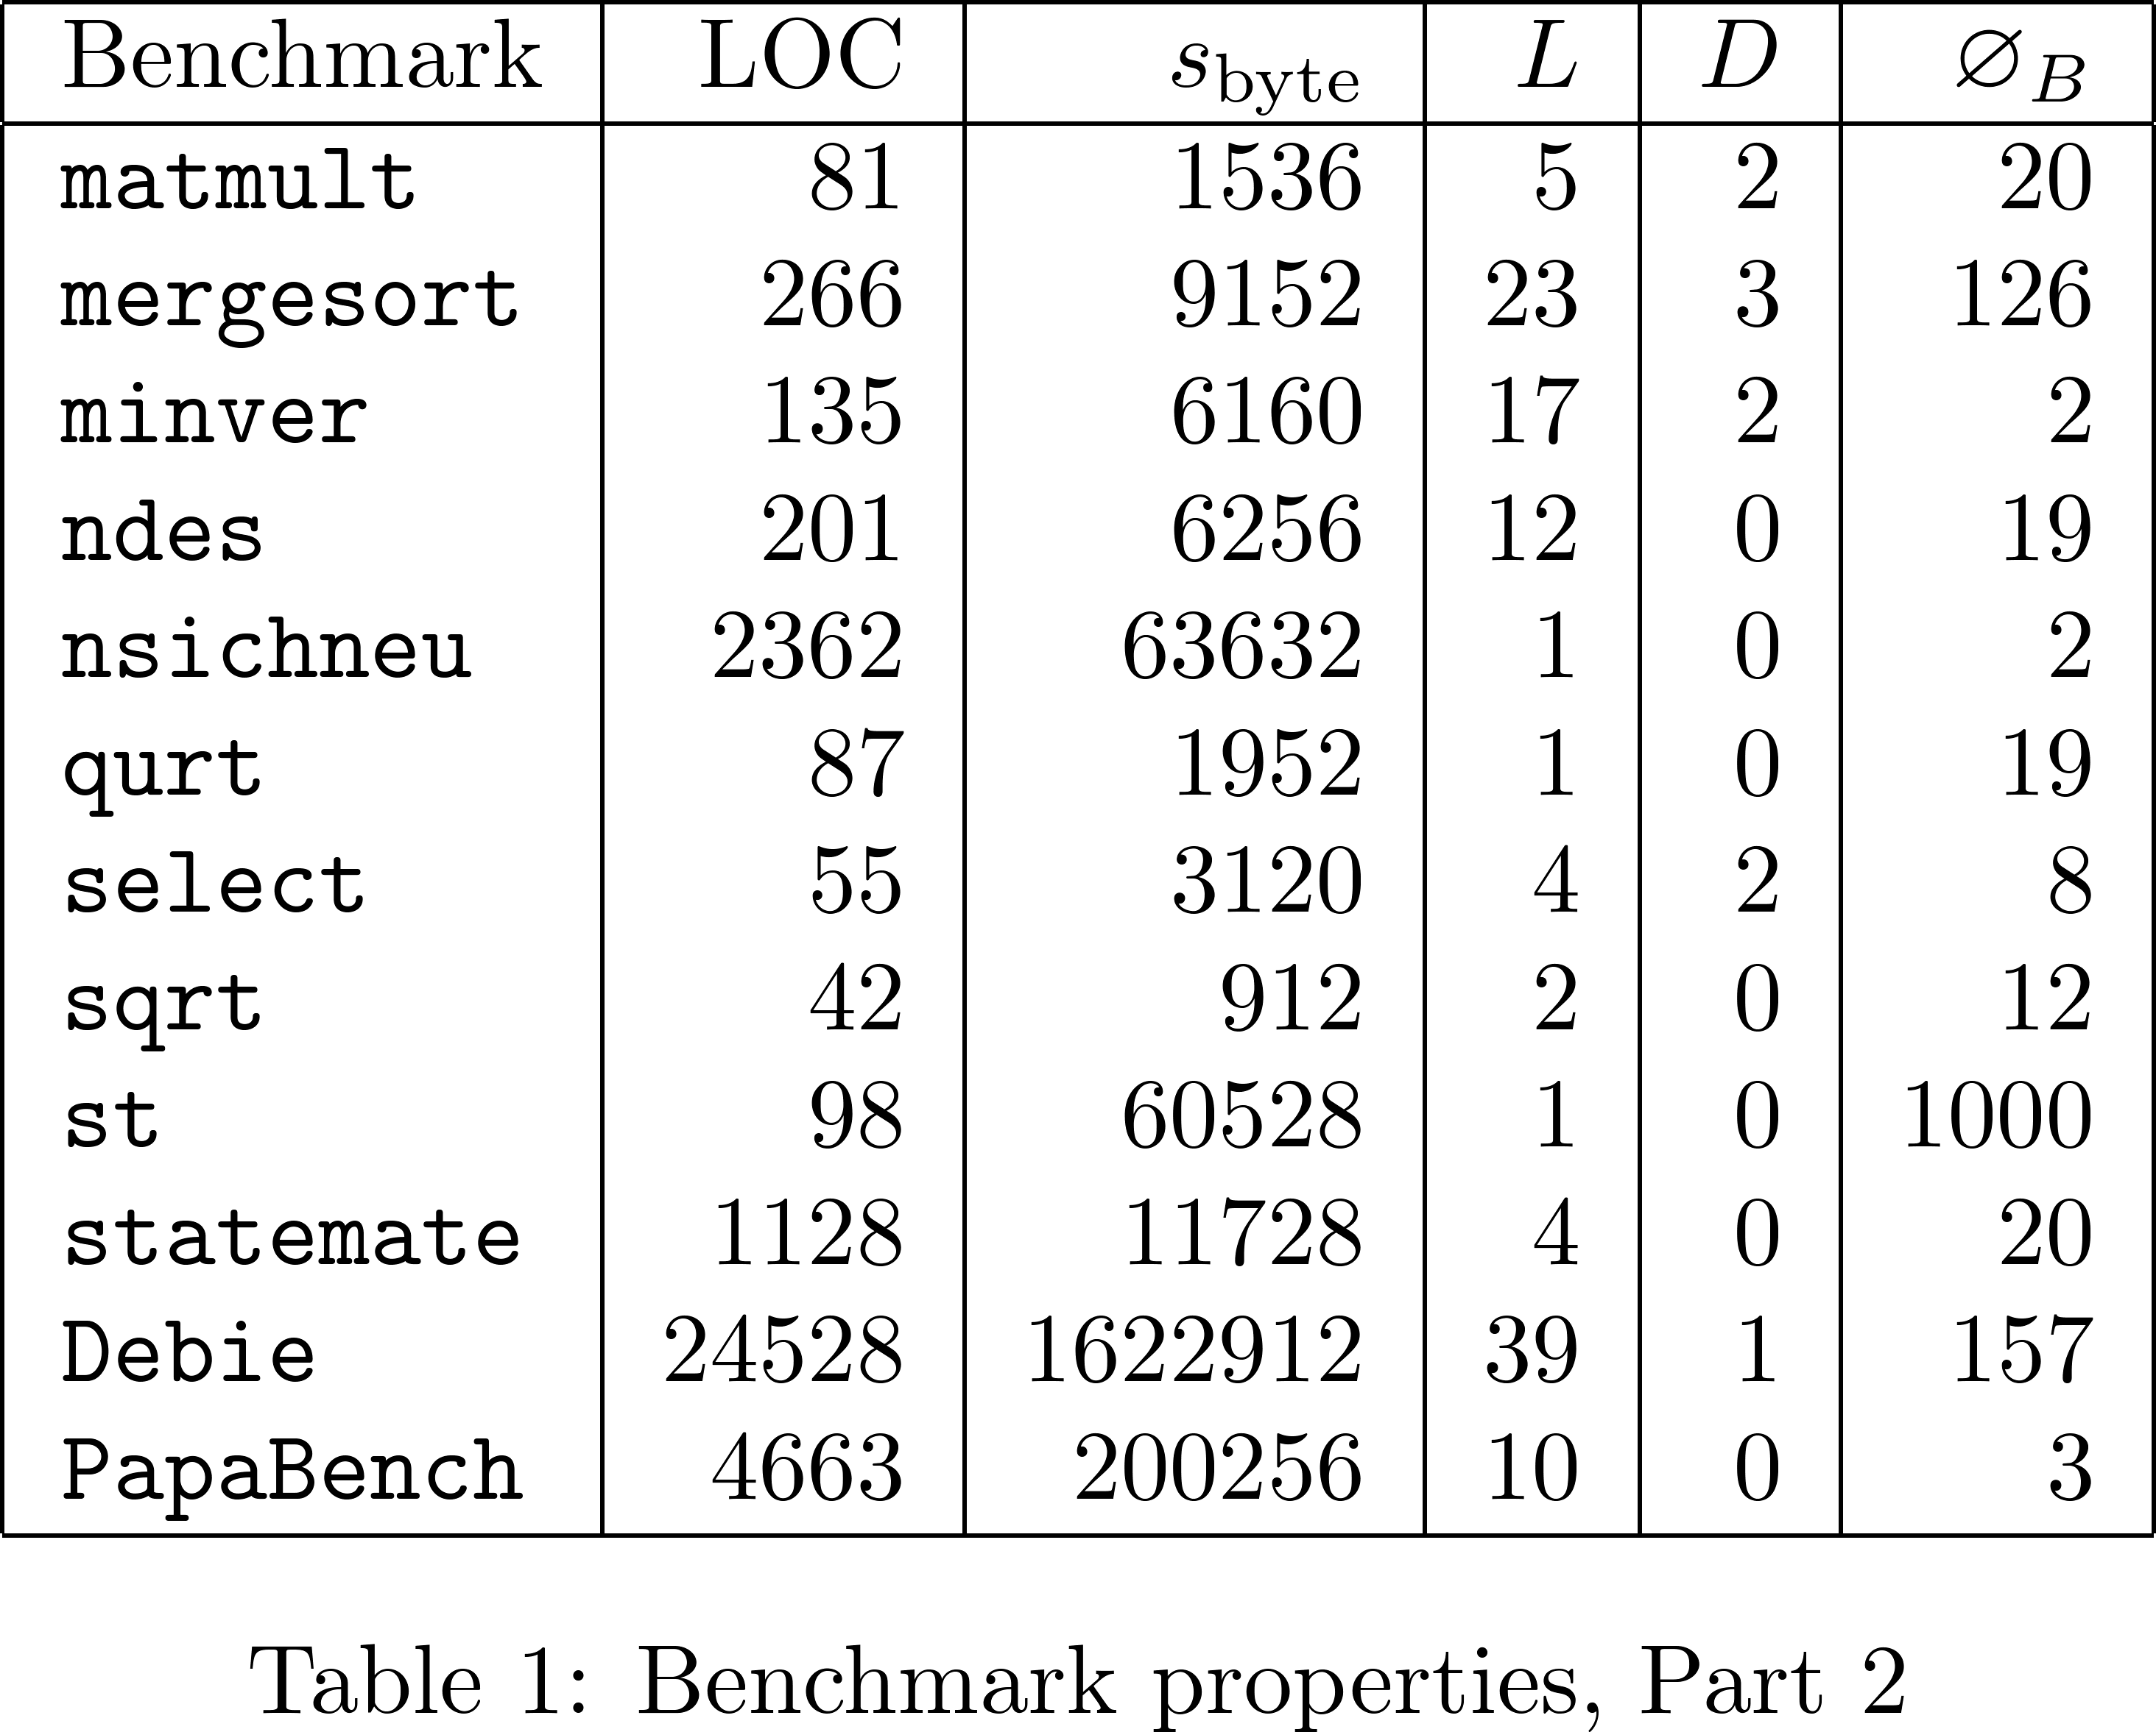
Benchmark Properties 2

Slide 31
Result Details for n=2, s=80

